Slide 1



Presentation by
Aman(10), Satyam(49), Sagar(51)
Sentence Auto Completor

Slide 2





N-Grams
N-grams are contiguous sequences of items that are collected from a sequence of text or speech corpus or almost any type of data. The n in n-grams specify the size of a number of items to consider, unigram for n =1, bigram for n = 2, and trigram for n = 3, and so on.
This is a sentence
“This”
”is”
“a”
“sentence”
“This is”
”is a”
“a sentence”
“This is a”
“is a sentence”
unigrams
bigrams
trigrams

Slide 3
The N-gram language model works by calculating the frequency of each N-gram in a large corpus of text. The frequency of these N-grams is then used to estimate the probability of a particular word given its context.
Let’s begin with P(w|h), the probability of a word w given some history h. Suppose history h is “its water is so transparent that” and we want to know the probability of the next word being “the” :
P(the|its water is so transparent that)
One such approach could be to use relative frequency counts to compute this probability, i.e., Out of the times we saw the history h, how many times was it followed by the word w
How does
N-Gram work?
P(the|its water is so transparent that)= C(its water is so transparent that the)
C(its water is so transparent that)
Intuitively it seems infeasible to perform this over an entire corpus; especially it is of a significant a size. This is the motivation behind the N-gram model, instead of using the entire corpus, we approximate this probability using just n previous words.

Slide 4
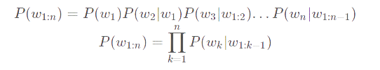
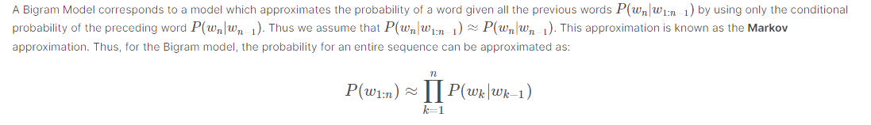
Intuitively it seems infeasible to perform this over an entire corpus; especially it is of a significant a size. This is the motivation behind the N-gram model, instead of using the entire corpus, we approximate this probability using just n previous words.
For instance if w1:n represents the sequence of words w1,w2...wn , then using the chain rule of probability we can write,
Bigram Model
A Bigram Model corresponds to a model that approximates the probability of a word given all the previous words P(wn|w1:n−1) by using only the conditional probability of the preceding word P(wn|wn−1). Thus we assume that P(wn|w1:n−1)≈P(wn|wn−1). This approximation is known as the Markov approximation. Thus, for the Bigram model, the probability for an entire sequence can be approximated as

Slide 5
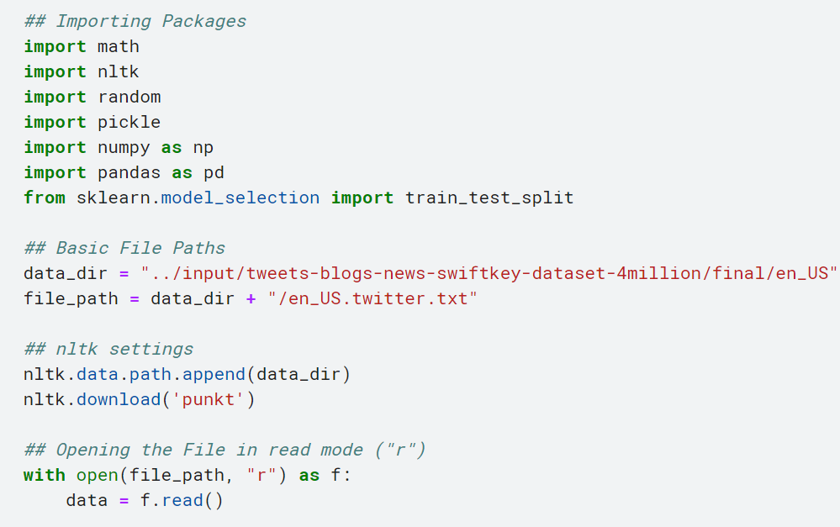
Setup

Slide 6
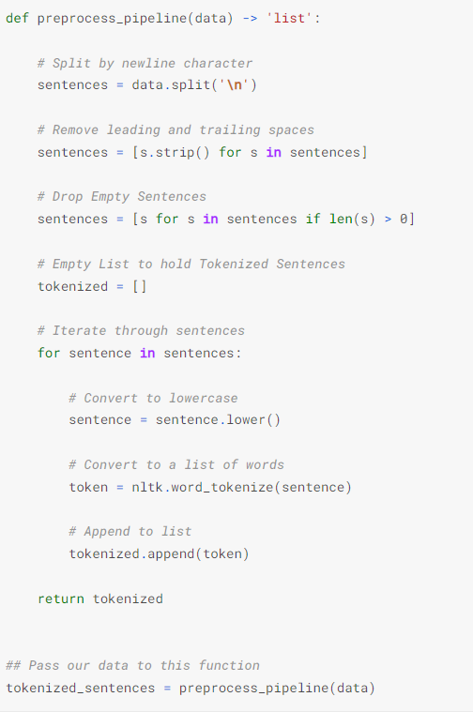
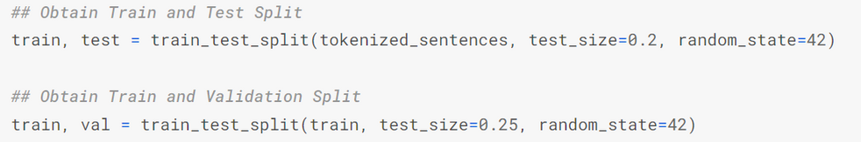
Preprocessing
We create a simple pipeline function which:
splits the datasets by the \n character
remove leading and trailing spaces
drop empty sentences.
Tokenize sentences using nltk.word_tokenize

Slide 7
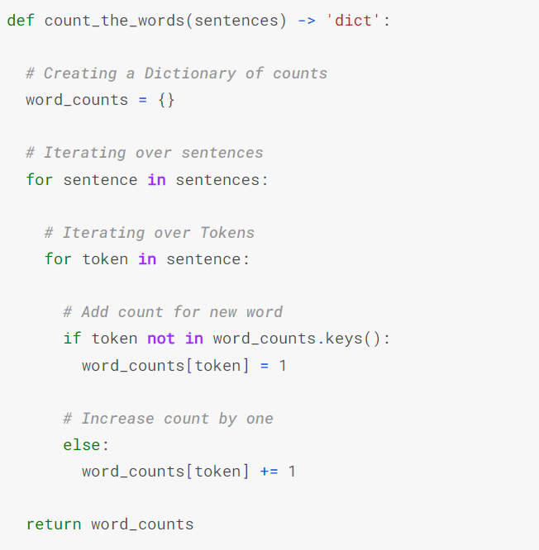
As our dataset is quite big, we'll only use those words that appear k times in our dataset. In this function, we'll create a frequency dictionary for our vocabulary.
Frequency Dictionary

Slide 8
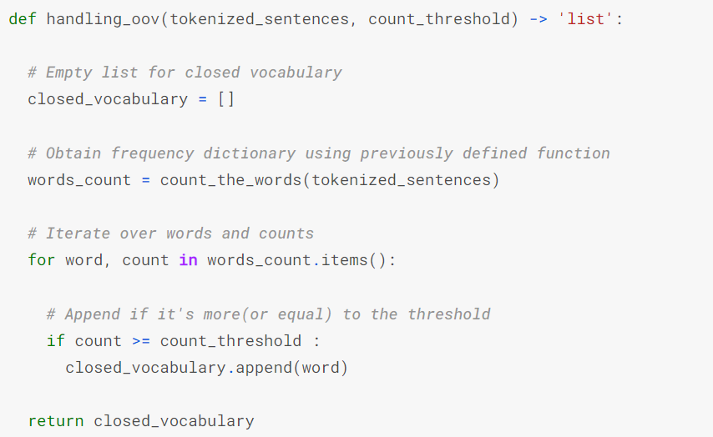
Creating Closed Vocabulary
One of the most essential steps in dealing with Textual data is handling Out-of-vocabulary words. This helps the model to handle words which are not present in the training corpus. First step in this process is to create a closed_vocabulary. This function creates a closed vocabulary containing only those words according to the count_threshold parameter

Slide 9
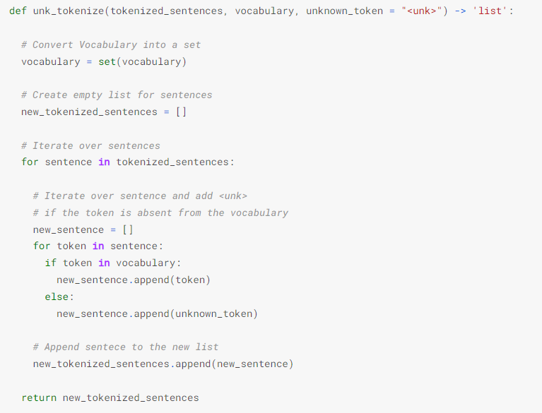
Adding UNK Tokens
In this function we'll add <unk> tokens, to those words which are not in the closed_vocabulary which we just made.

Slide 10
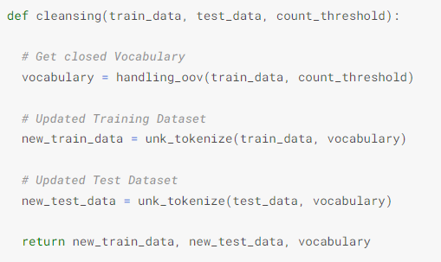
Final Cleaning

Slide 11
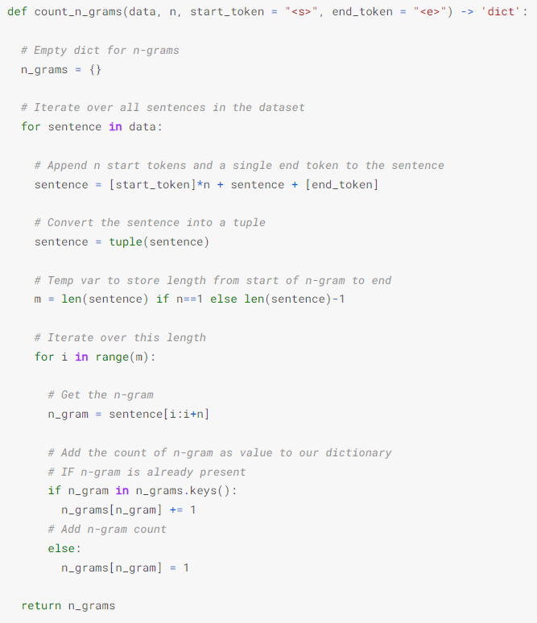

Model Building
This is a helper function, which will come in handy during inference. This function returns a mapping from n-grams to their frequency in the dataset

Slide 12
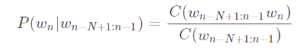
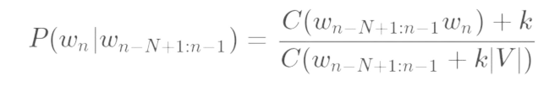
K-Smoothing
This function calculates the priority for the next word given the prior n-gram. This function also implements k-smoothing which helps account for unseen n-grams. Using the previously defined formula:
But what if we come across a n-gram that wasn't in the training set. Then our denominator would become zero and our definition of probability would become invalid. Thus, we use k-smoothing, which adds a positive constant k to each numerator, and k×|V| in the denominator, where |V| is the number of words in the vocabulary. This ensures any n-gram with zero count has the same probability of 1/|V|. Thus, our original estimation get's modified to:

Slide 13
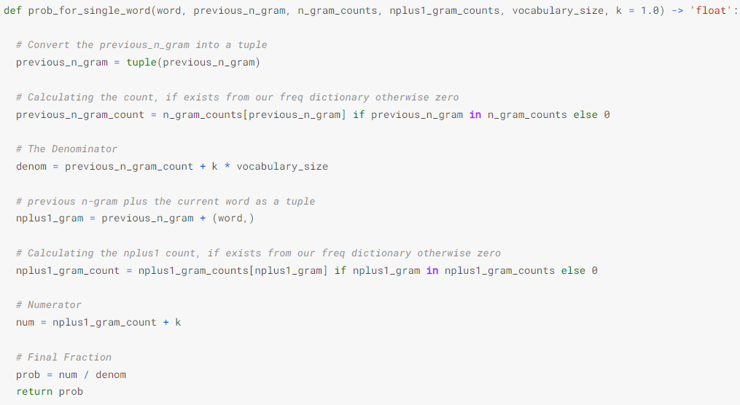
K-Smoothing

Slide 14
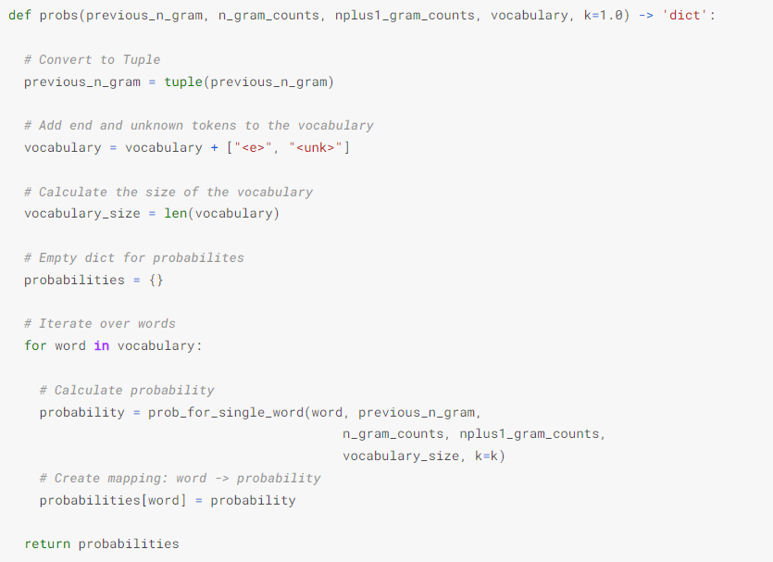
K-Smoothing

Slide 15
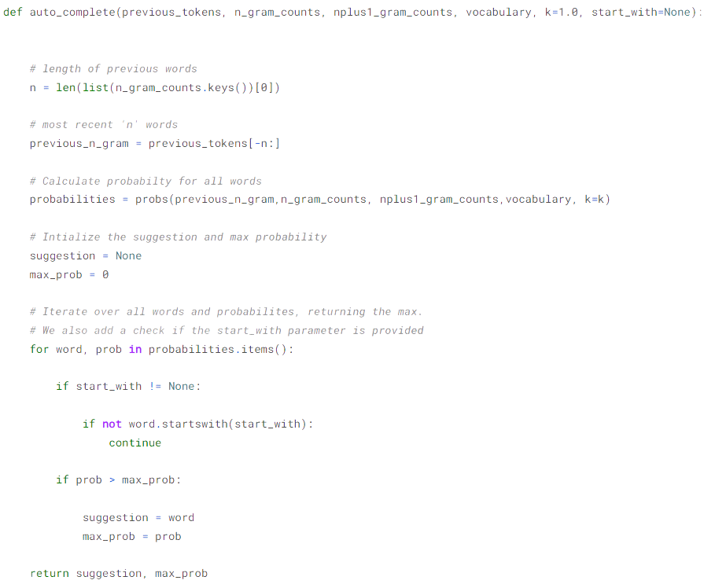
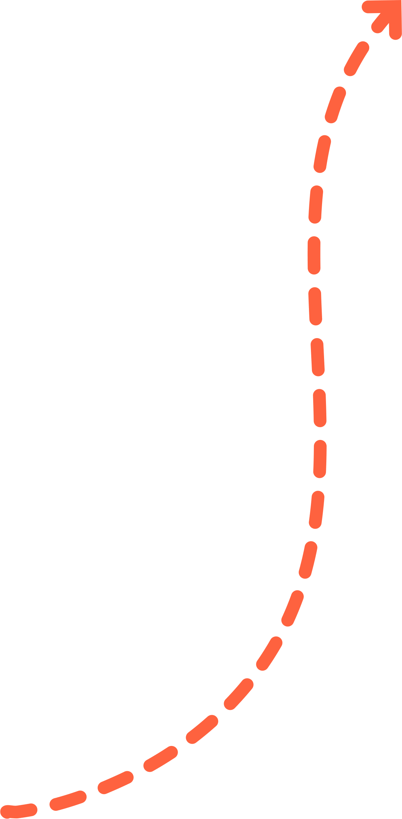
Auto-Complete System
Finally, we build our auto_complete fn. We simply loop over all the words in the vocabulary assuming that they can be the next word and then return the word with it's probability.

Slide 16
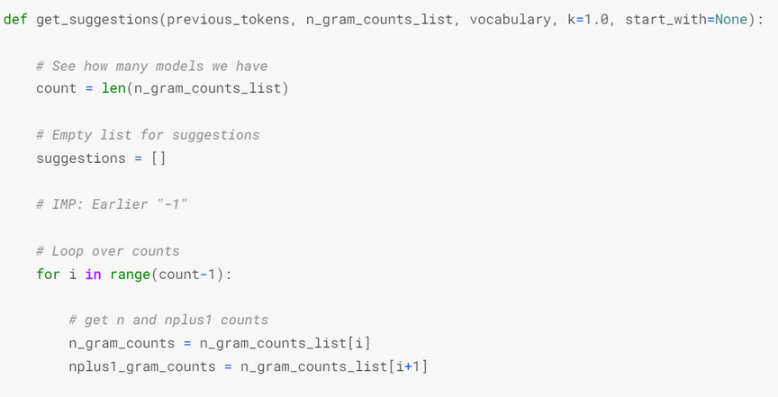
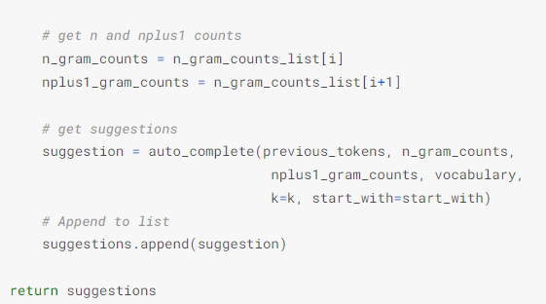
Auto-Complete System
We can also loop over all the various n-gram models to get multiple suggestions. This function just extends from the previously defined function by taking multiple n-gram counts instead of one. This allows us to take unigram, bigram, .. counts into account as well.

Slide 17
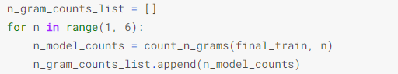
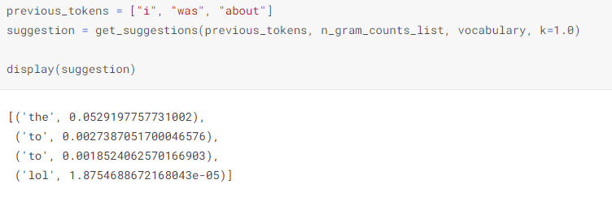
Result
Here, we create a list of n-gram counts for a arbitrary range (1,6)
Let's give it a sample input of "i was about" in a tokenized manner and get multiple suggestions using the above calculated n-gram counts with smoothing-factor, k = 1.0
Output

Slide 18
LSTM
LSTM (Long Short-Term Memory) is a recurrent neural network (RNN) architecture widely used in Deep Learning. It excels at capturing long-term dependencies, making it ideal for sequence prediction tasks.
Unlike traditional neural networks, LSTM incorporates feedback connections, allowing it to process entire sequences of data, not just individual data points. This makes it highly effective in understanding and predicting patterns in sequential data like time series, text, and speech.`
Input Layer: This is responsible for taking input sequence.
LSTM Layer: It calculates the output using LSTM units and returns hidden and cell states. In our case we have added 100 units in the layer, that can be fine-tuned later.
Dropout Layer: This layer is responsible for regularisation which means it prevents over-fitting. this is done by turning off the activations of some neurons in the LSTM layer.
Output Layer: This Computes the probability of our prediction.

Slide 19
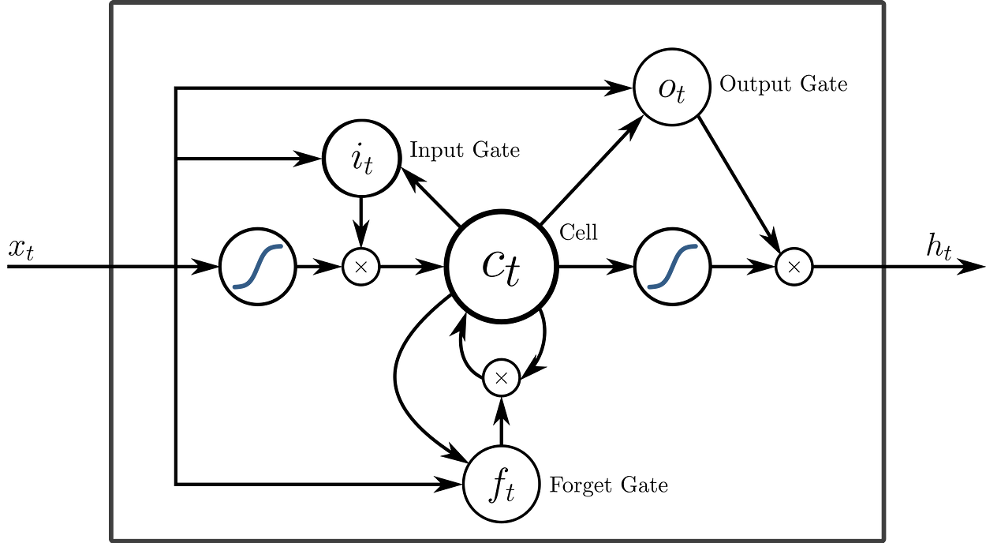
LSTM

Slide 20
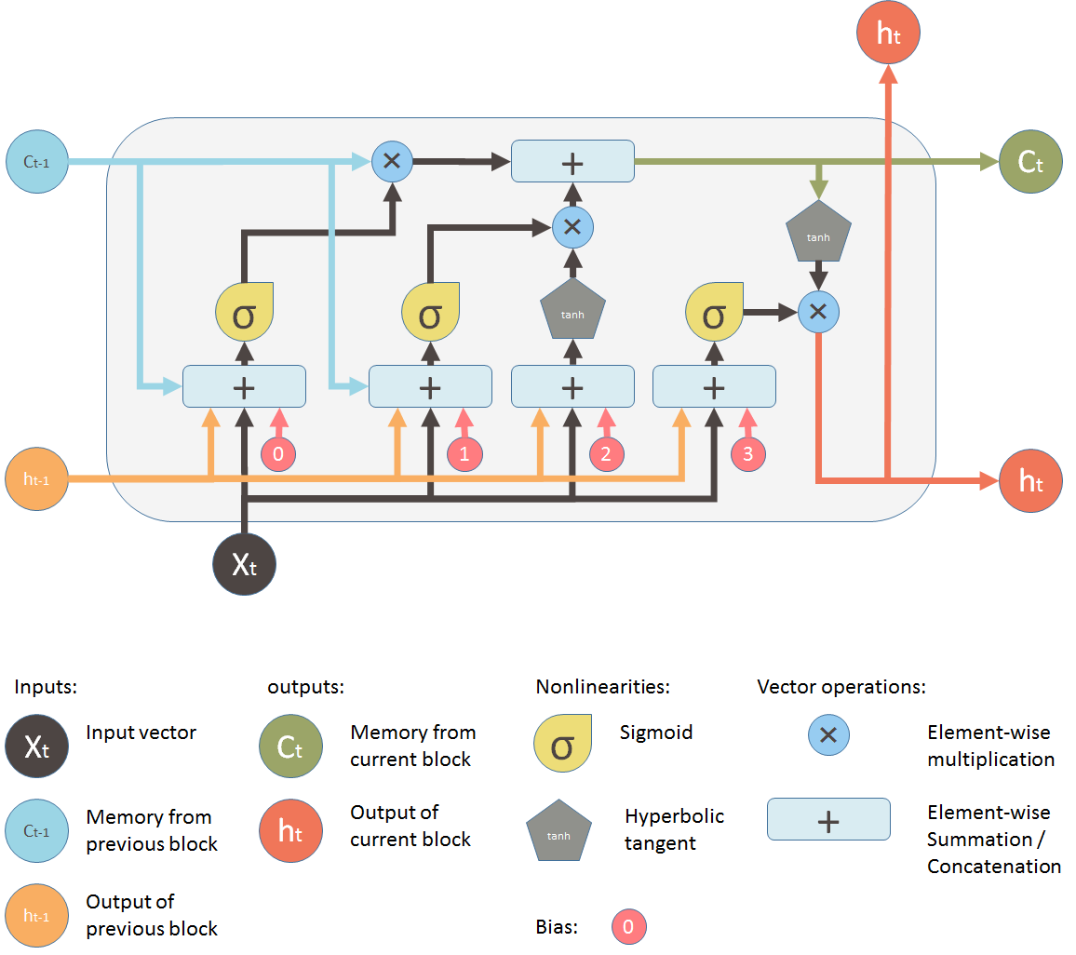
LSTM

Slide 21
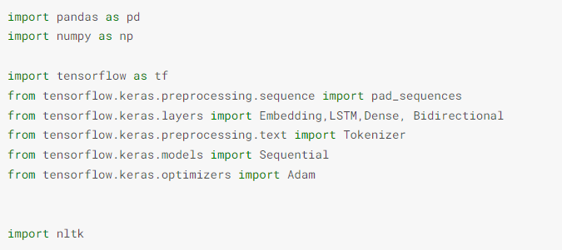
Setup

Slide 22
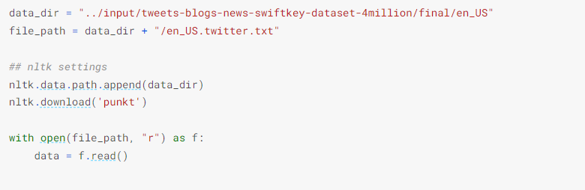
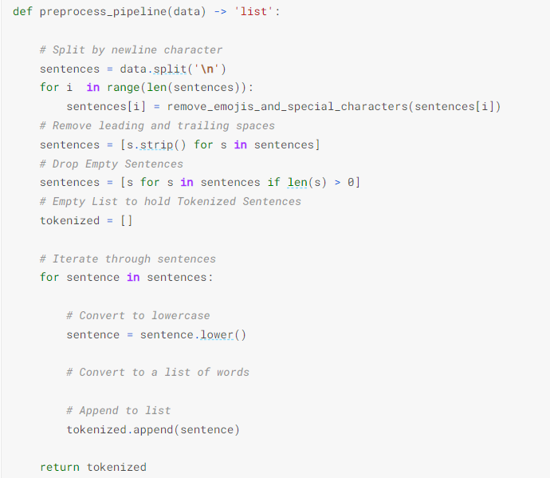
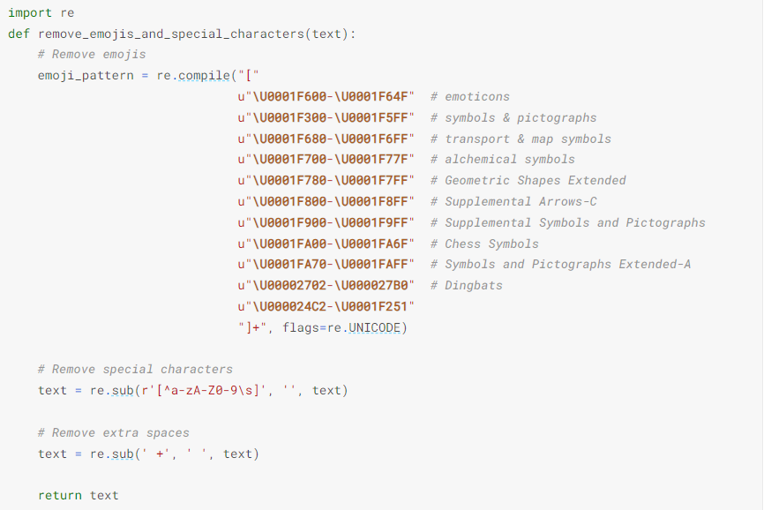
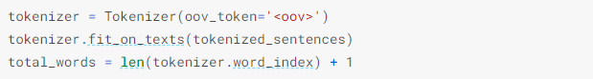
Preprocessing

Slide 23
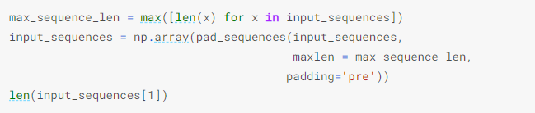
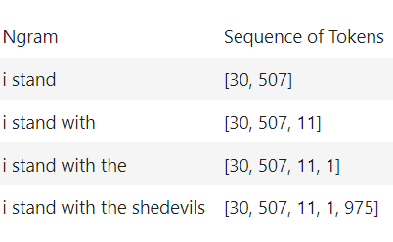
Padding is a special form of masking where the masked steps are at the start or the end of a sequence. Padding comes from the need to encode sequence data into contiguous batches: in order to make all sequences in a batch fit a given standard length, it is necessary to pad or truncate some sequences.
Pad Sequencing

Slide 24
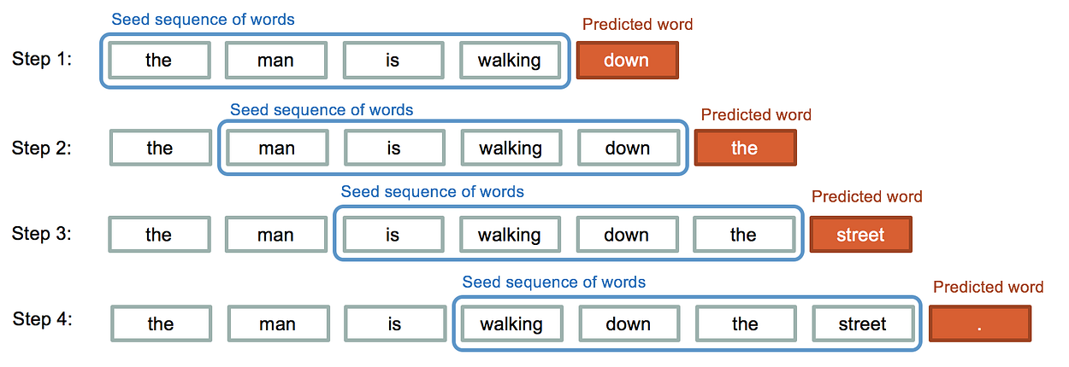
Pad Sequencing
As you see that inp_sequence is an n-gram sequence that is required for training next-word prediction. we

Slide 25
Preparing features and labels

Slide 26
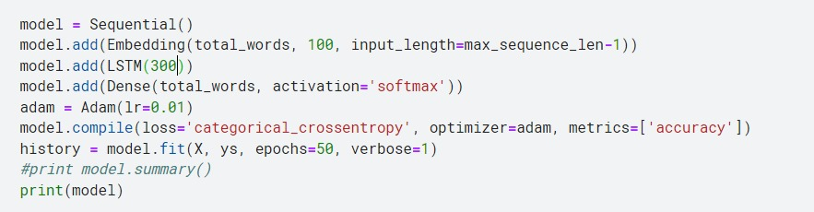
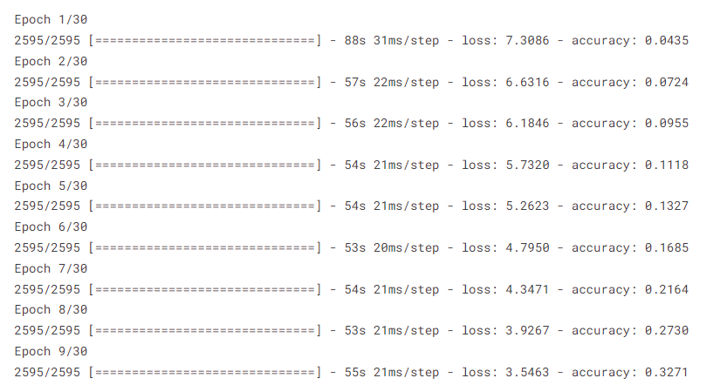
Model

Slide 27
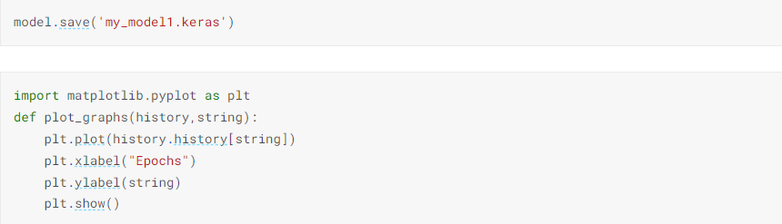
Graphs

Slide 28
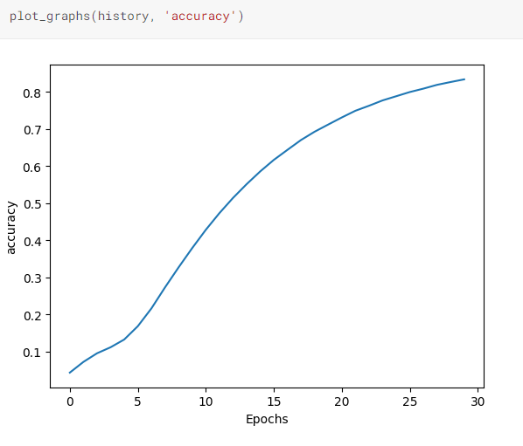
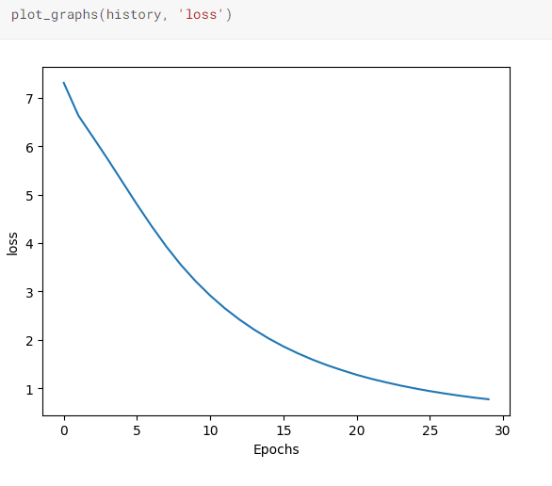
Graphs

Slide 29
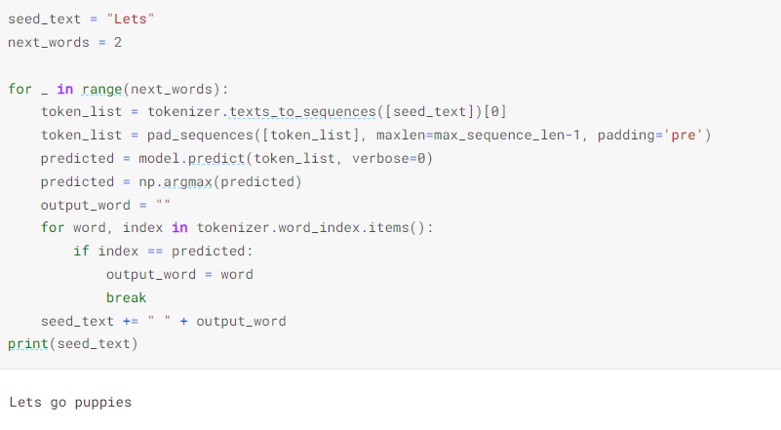
Result

Slide 30
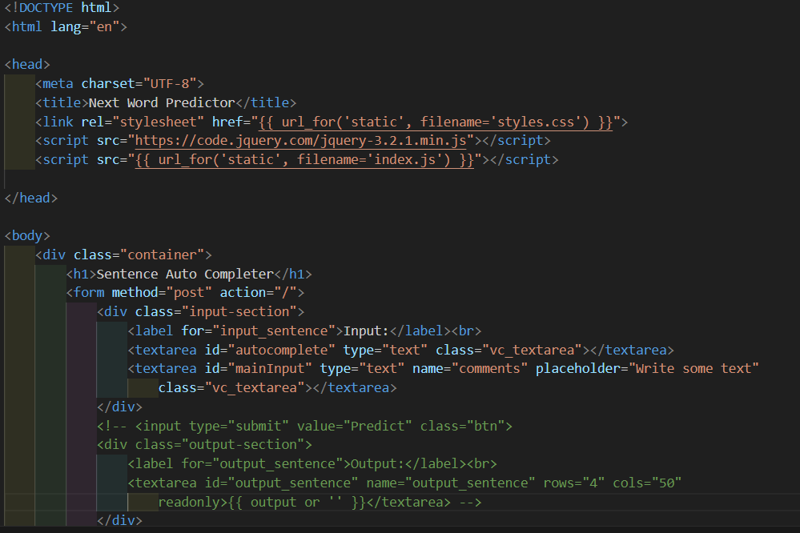
HTML

Slide 31
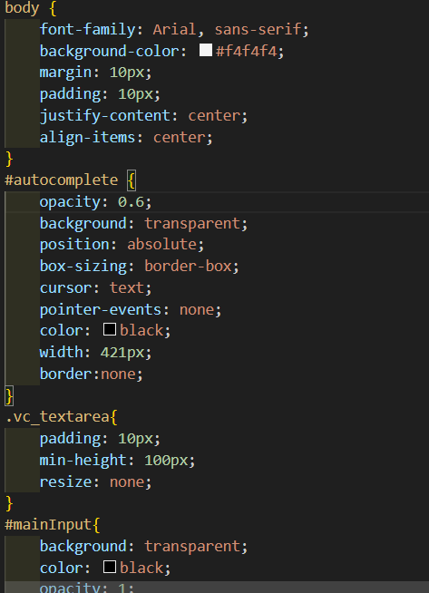
CSS

Slide 32
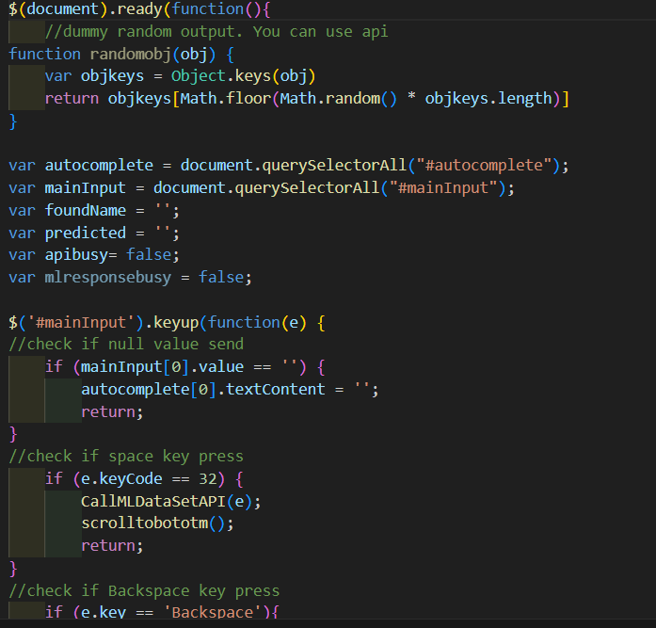
JS

Slide 33
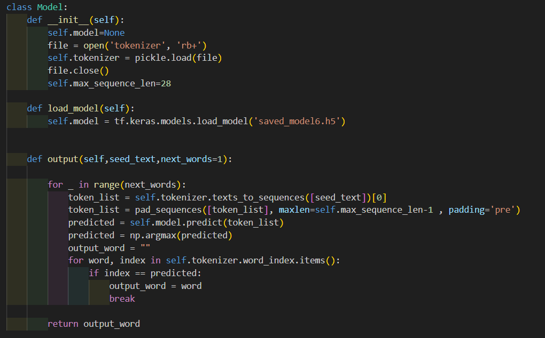
Model

Slide 34
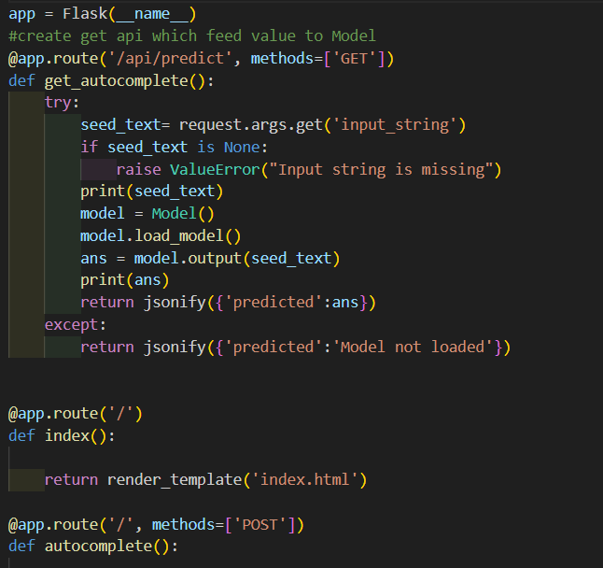
Flask File

Slide 35
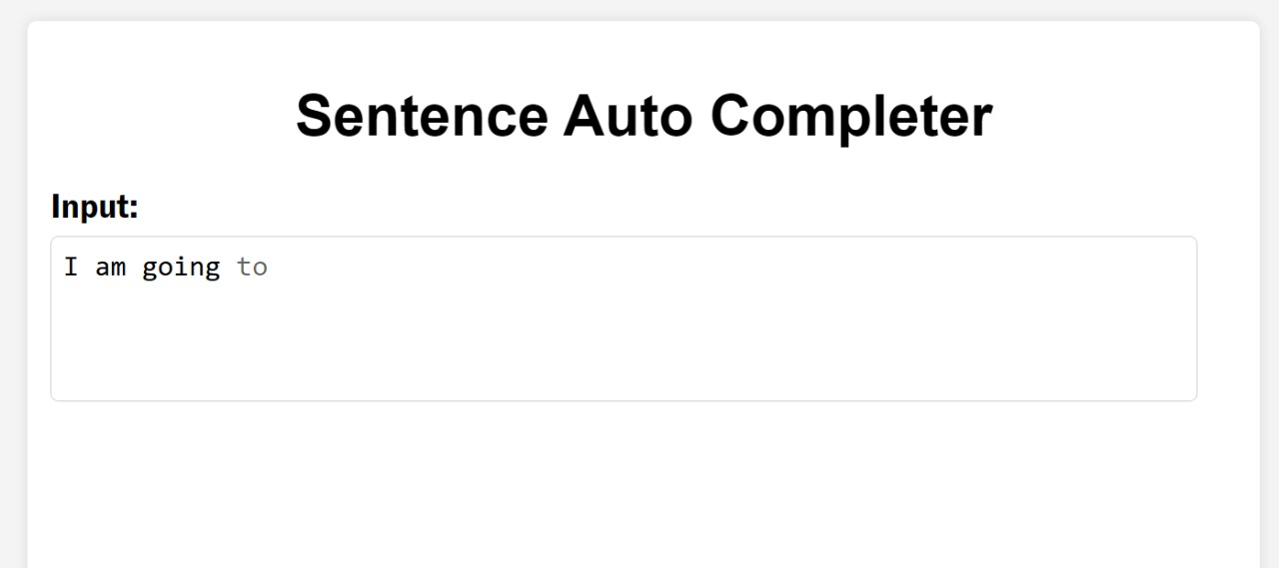
Working

Slide 36
Thank
You!
Presentation by
Aman(10), Satyam(49), Sagar(51)
University of Delhi | 2023

